Slide 1
Time to Move
Super exciting spectacular task

Slide 2
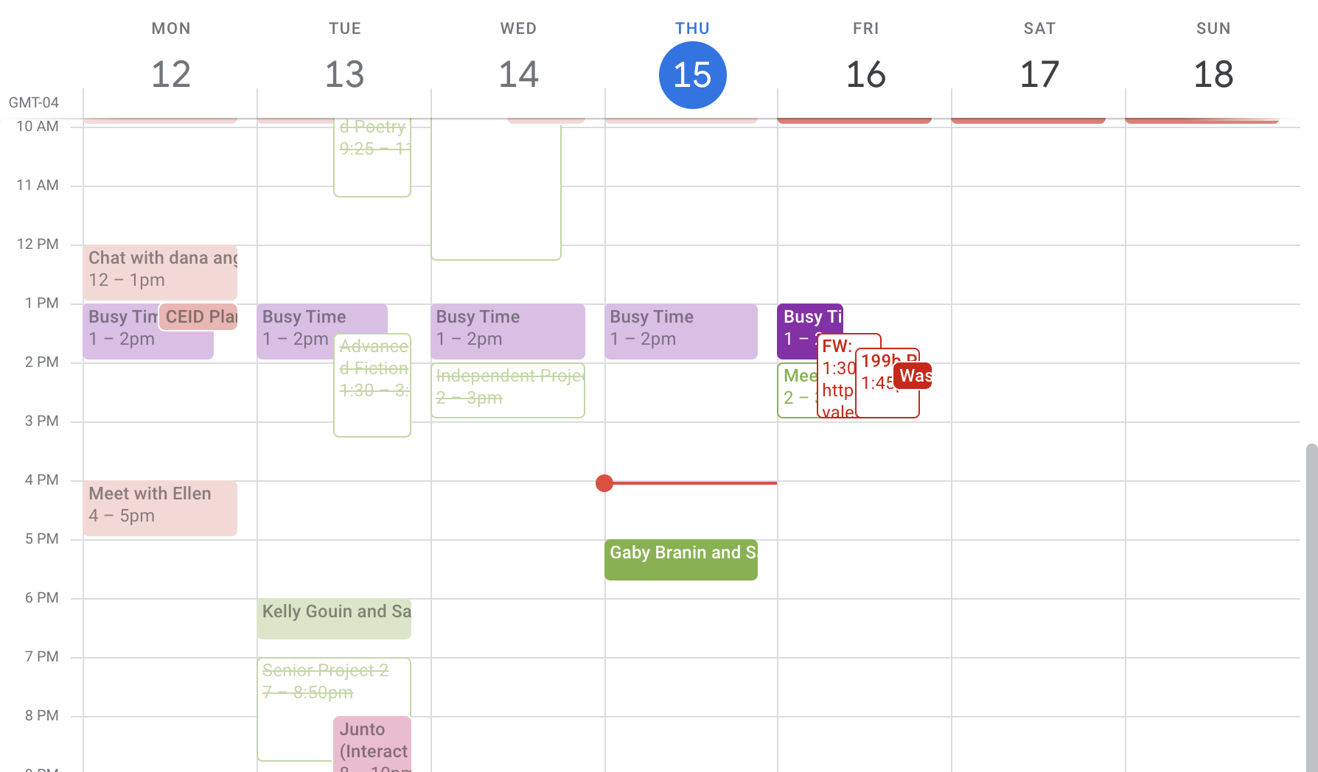

Slide 3
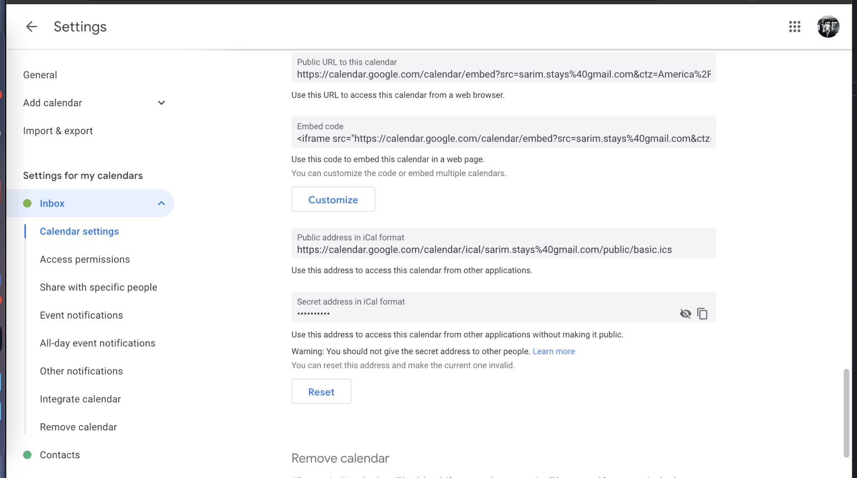
Google Calendar auth too hard, iCal feeds instead

Slide 4
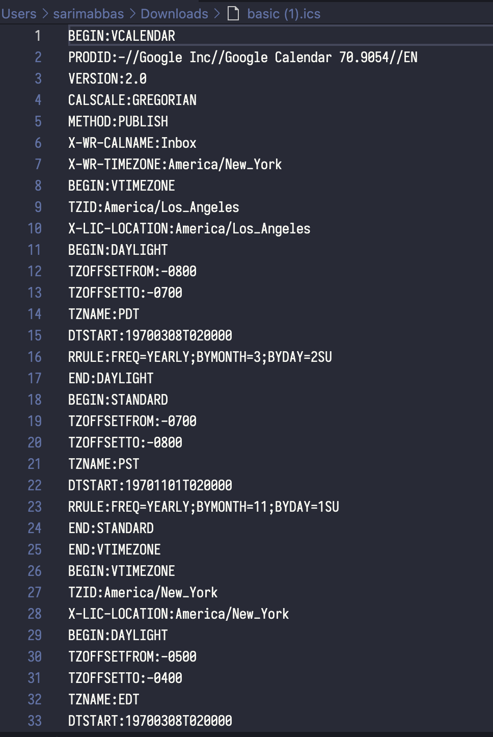
iCal feed is just a text file full of stuff

Slide 5
But all it’s saying is...
[
{
name: “lunch with John”,
start: “april 1st, 10 am ET”,
end: “april 1st, 1pm ET”,
},
{
name: “office hours for biology”,
start: …..
end: ….
}
]

Slide 6
Algorithm
Do we have to plan for the whole week or just for today?
Get all of today’s events
Get all the free time between them
Schedule/suggest breaks in that free time

Slide 7
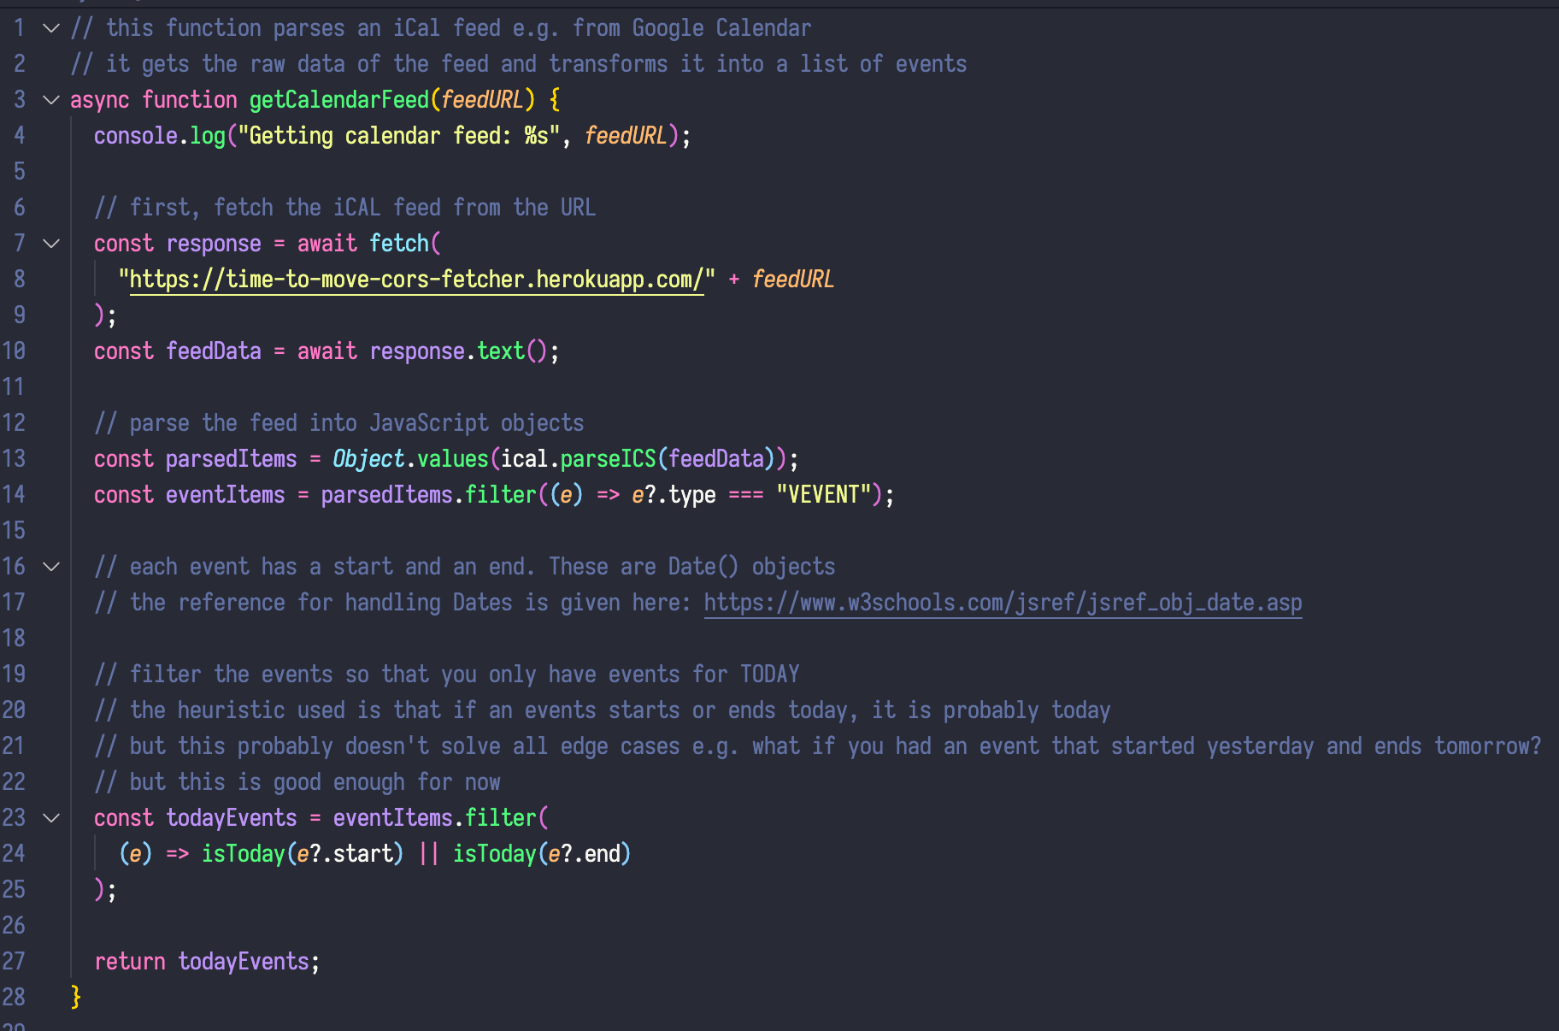
Get all of today’s events
I’ve taken care of that

Slide 8
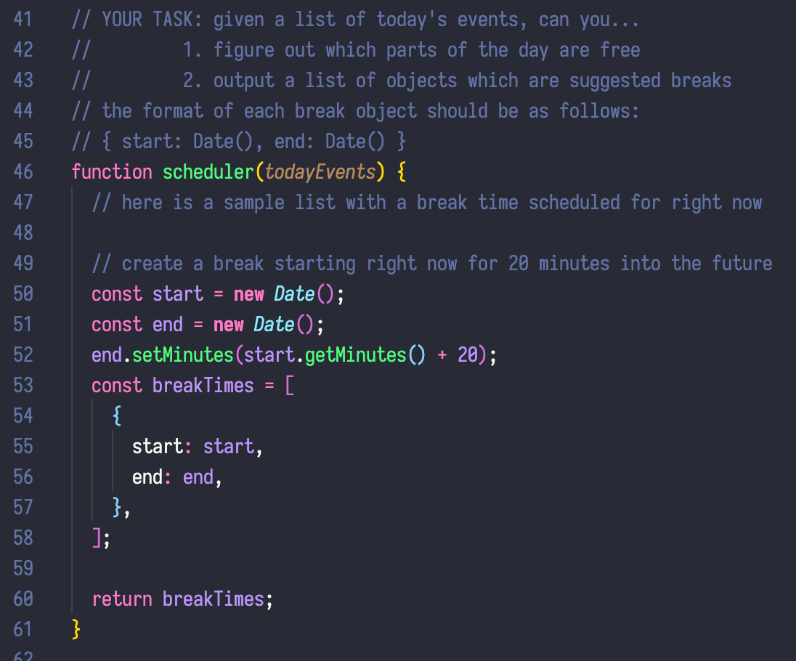
Suggest times in between breaks
Your task
The MVP of your product
Fill in the code

Slide 9
This will help
https://www.w3schools.com/jsref/jsref_obj_date.asp
https://developer.mozilla.org/en-US/docs/Web/JavaScript/Reference/Global_Objects/Date

